Slide 1
Tools and Design
EDC&I 505 J
11 April 2012

Slide 2
Our Agenda Today
New Tools:
What did you find?
How did you evaluate them?
Which one will you present, and why?
Designing our asynchronous session for 4/18:
What tools should we use for the session?
How should presenters present?
What should the assignments/work be? (And timeline, etc.)
Discuss Horton / Brown / Hsieh
Restructure our in-class task from last week (“An ID Exercise about ID Exercises”

Slide 3
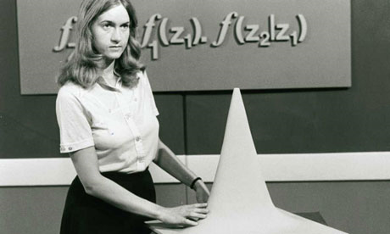
Old Tools
What did distance learning (not online) look like? (At best…)
Lectures delivered via TV, radio
Students work with structured texts, packets, kits
Students submit assignments (and receive feedback) via snail mail
Phone consultations with instructor
The first Open University TV lecture, 1971

Slide 4
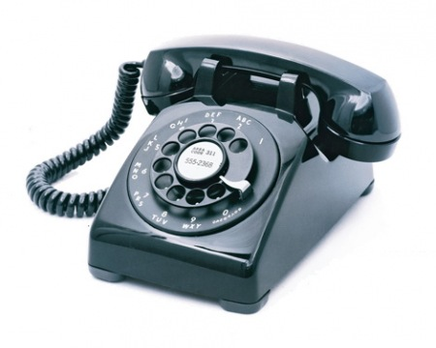
Old Tool Variations
Dial up interface
Dial-up audio or video materials
800 number phone consultations
“Bicycled” video tapes (to multiple sites)

Slide 5
Online and Its Variants
Initial period (ca. 1995-2002)
Text-based forums
Instructor-learner interaction via email
Low bandwidth
Intermediate period (ca. 2002-2009)
Tool variation (web conferencing, annotation)
Advent of social media
Current period (2009-now)
More capture, annotation, and interaction options
Greater tool variety

Slide 6
New Tools You Found

Slide 7
Designing Our Asynchronous Session for April 18
What tools should we use for the session?
Catalyst SK to create GoPost for this and send you the link
How should presenters present?
Start with statement on GoPost, then anything else that’s relevant (other tools, etc.)
What should the assignments/work be? (And timeline, etc.; see next slide)
Brief response – representing 5 min. effort per person
How should we discuss readings?
See info. on GoPost site

Slide 8
Timeline for Next Session
Sun | Mon | Tues | Weds | Thurs | Fri | Sat
 |  |  | 4/11 (today) | 4/12 Presenters design | 4/13 Presenters design | 4/14 Presenters design
4/15 Presenters design | 4/16 Presenters design | 4/17 Presenters Post by now | 4/18 (asynch “session”) Audience Respond | 4/19 Audience Respond | 4/20 Audience Respond | 4/21 Audience Respond
4/22 Audience Respond | 4/23 Presenters respond | 4/24 Presenters respond | 4/25 (next f²f meeting)

Slide 9
Rubric (What I’ll be Looking for in Your Presentations)
1-2 page description of the tool
Covering:
Uses for particular applications in online learning
Its support for learners (cf. to face-to-face instruction)
Constraints that might affect its use
URL or where to access information about the tool
Completeness of the description; relevance for the task(s) suggested
Quality of the presentation (clarity; organization)
Imaginative/creative approach to the use of the tool

Slide 10
Questions: Horton – Brown - Hsieh
Horton Ch. 2:
How would you apply his “absorb type activities” to design of your presentations on tools/practices?
Which would you be most/least likely to use, and why?
Horton Ch. 9:
How could/should you adapt your presentations to make them appropriate for mobile learners?
Brown & al.:
How could learners in an OL setting introduce themselves to each other so as to foster feelings of mutual trust, credibility?
Hsieh & Cho:
Given that learners prefer and intend to use ISI tools more than SP tools, what places would it still make sense to use SP tools?

Slide 11
Standardizing a Common Referent
Instead of “An ID Exercise about ID Exercises…” (last week’s confusing example)
Develop a common referent (design task) that we can use to think about different tools, practices
Suggestion: “Preparing for your masters defense/R&I/Oral General Exams/Dissertation Defense” -- ?
Or…

Slide 12
For Next Week
Our asynchronous session
Treat this seriously, in terms of your participation, timing, etc.!
In addition to “doing the work,” pay attention to how you feel, react as you are doing the work – in other words, approach it at a “meta” level as a “cyborg anthropologist”
Read Horton; Williams et al.

